Slide 1
Gaelscoil Thulach na nÓg Cruinniú Cinnbliana 2016 Coiste na dTuismitheoirí Parents Association AGM 2016

Slide 2
Agenda
Mointuairiscí Cruinniú Cinnbhliana 2015 (Minutes)
Parents Association Review
Membership of Parents Association Committee
Activities 2015/2016
Finances 2015/2016
School Treasurer – Declan Alyward
Topics raised by parents
Mairín Ní Chonaire
Chair of School Board – Séamus Kavanagh
School Update – Séan Ó Laimhín

Slide 3
Role of Parents Association Committee (PAC)
Through the PAC, parents/guardians work together for the best possible education of our children.
The PAC works with the Principal, Staff and the Board of Management to build effective partnership between home & school.
Act as a forum for discussion on aspects of school life on behalf of the parent body.
Every family is a member of the Parents Association.

Slide 4
Current Committee
Caroline O’Hara – Cathaoirleach
Trinda Duffy – Runaí
Bernadette O’Connor – Cisteoir
Michelle Fennell
Barbara McGinn
Michael Lawlor
Laura Noonan
Siobhan Murphy
Janice Dunwoody
Stuart Montgomery
Ruth Tolan

Slide 5
Election of New Committee Members
Siobhan Murphy
Stuart Montgomery
Trevor Maher
Darren Costello
Antje Rooney
Karl Murphy
Therese McIIroy
Eimear O’Neill
Sinéad Scully
Ciara O’Gorman
NEW MEMBERS & IDEAS WELCOME

Slide 6
Review of Activities 2015 - 2016
Oíche Samhain Mór Siúil - Halloween Parade
Goethe Institute Deutschmobil – 13 Oct Visit
Daidí na Nollaig ar Scoil
Open day & evening for Parents & Community in Jan 2016
Gaelscoil Féilire 2016 & Cartaí Nollaig
Zeeko – Internet Safety for Children & Parents

Slide 7
Events Continued……….
Lá Fhéile Pádraig - Parade
Cóisir an Chéad Chomaoineach – First Communion Party
Cóisir Rang Sé – 6th Class Graduation
Gailf - Golf Classic to fund School Library
“Buy A Brick” - Postponed

Slide 8
Tuairisc an Cisteoir
2015 - 2016

Slide 9
Funds Raised
Event € | 2015 | 2016
Pupil Insurance Scheme | 427 | 530
Oíche Samhain Mór Siúil | 3,741 | 3,560
Féilire & Cartaí Nollaig | 4,562 | 4,332
Who Wants to be a Thousandaire? | 25,964 | -
Golf 2015 | 2,110 | 5,672
Total Funds Raised | 36,804 | 14,094

Slide 10
Expenditure
Item € | 2015 | 2016
PAC Insurance | 160 | 160
Daidí na Nollaig | 831 | 592
Communion Party | 786 | 500
Rang 6 Graduation | 270 | 245
National Parents Council | 75 | 90
Tables for New School | 266
Bank Fees | 106 | 111
Misc Expenses | 143 | 513
TOTAL EXPENDITURE | 2,637 | 2,211

Slide 11
Bank Account Balance
 | €
Balance in account Sept 2015 | 817
Income | 14,094
Less Operating Expenses | (2,211)
Total | 12,700
Less: Capital Expenditure in 2015/16 | 11,198
Balance in Account Sept 2016 | 1,502

Slide 12
What the money was spent on?
Description | Cost €
Notice Boards | 4,000
Zeeko Training Course | 600
New Tables | 598
Fit out of School Library | 6,000
Total | 11,198
Other Funds Raised from Parents Skipathon, Jersey Day, Cake Sale, Year End Concerts | 5,000

Slide 13
Huge thanks to all our parents and sponsors
Go Raibh Míle Maith Agaibh!

Slide 14
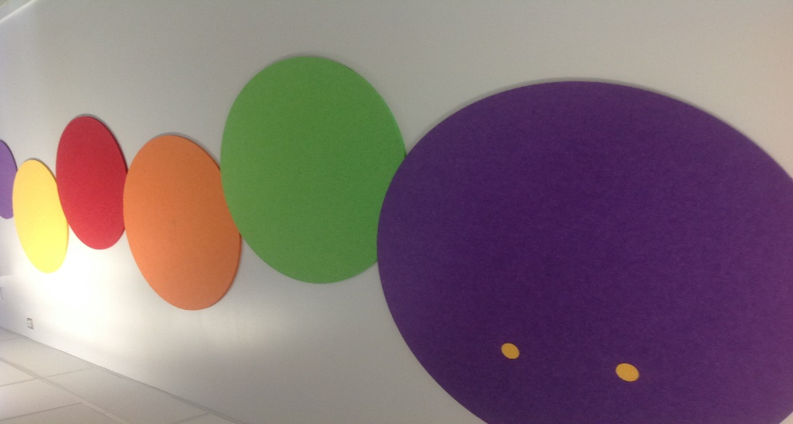

Slide 15
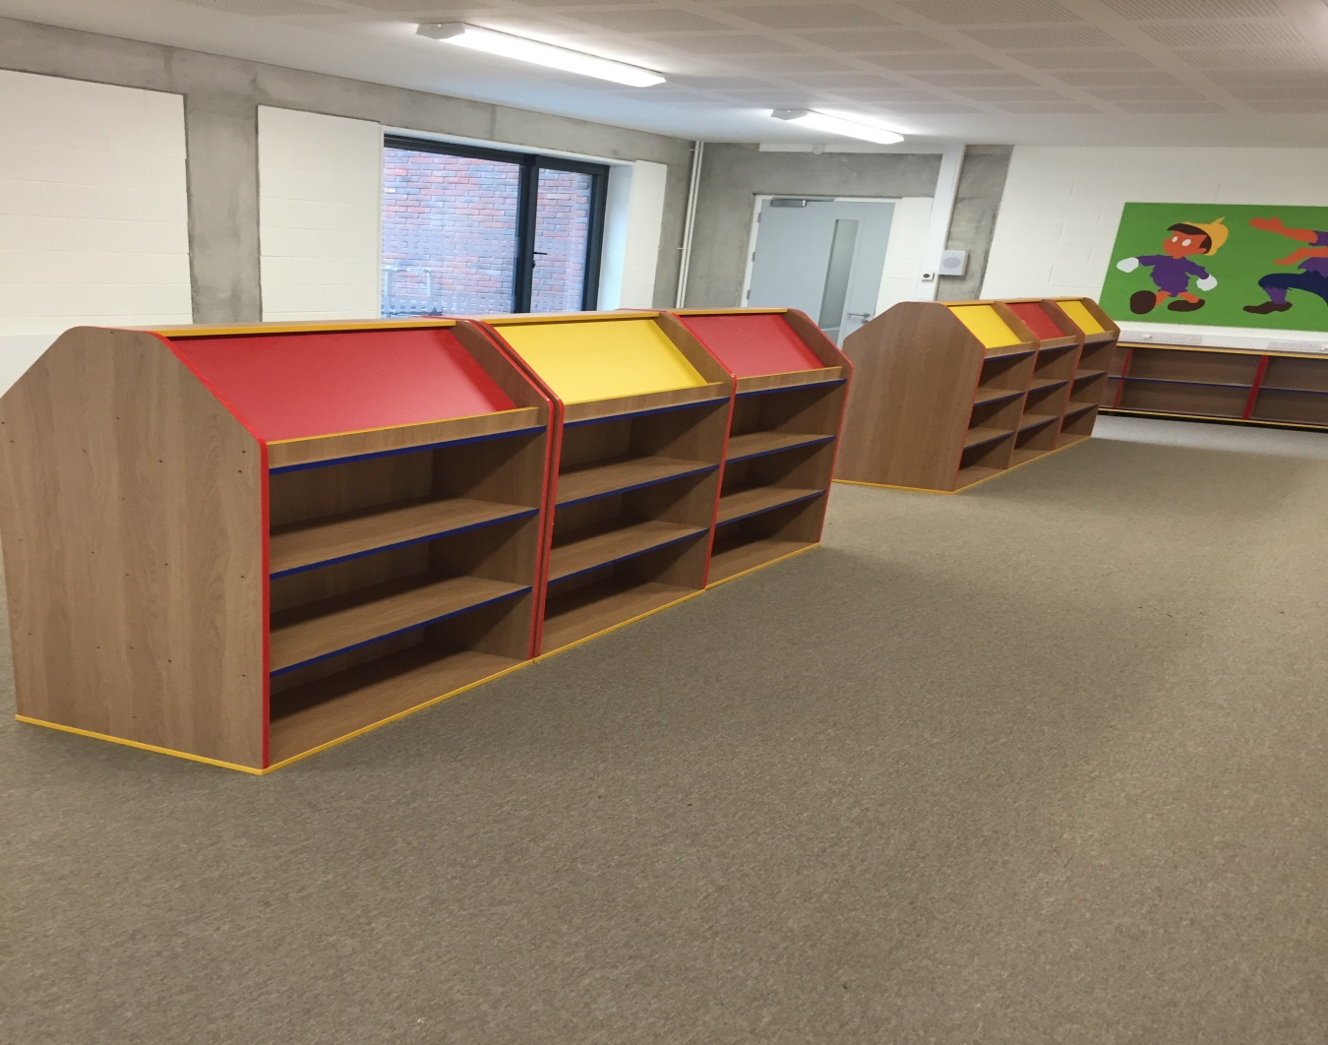
What Next?.......
New Library by November 2016
Book Drive for books

Slide 16
What next?..........
Goethe Institute Deutschmobil – Introduction to German
Coming to school 6th Oct – Rang 3/4/5 & 6
www.Goethe.de/irland

Slide 17
School Treasurer
Financial Report 2015 – 2016
Declan Alyward
Cisteoir BOM

Slide 18
Fáltais
Deontais |  |  |  | € | € | €
Scoil Nua |  |  |  | 116,100
Cíos |  |  |  | 73,804
Caipitíocht |  |  |  | 49,408
Seirbhísí Fo-ghabhálacha |  |  |  | 39,168
Mionoibreacha |  |  |  | 9,903
Eile |  |  |  | 7,270
 |  |  |  |  | 295,653
Deonúcháin |  |  |  |  | 60,027
Snamh/ Club obair Baile/Turas/Tuismitheori /Airgid Ranga
Cumann Na dTuismitheoirí |  |  |  |  | 45,000
 |  |  |  |  |  | 400,680

Slide 19
Íocaíochtaí |  |  | € |  | €
Scoil Nua |  |  | 212,514
Cios |  |  | 72,065
Pá (Rúnaí, Cothabhála, Club Obair Bhaile) |  |  | 62,778
Eile |  |  | 25,974
Glantoireacht |  |  | 21,319
Solas / Gás/ Uisce/ árachas |  |  | 17,813
Busanna |  |  | 11,790
Tacaíocht Foghlama |  |  | 11,962
Priontáil |  |  | 11,285
Snamh / Turais |  |  | 10,461
ICT/ Web |  |  | 6,462
Teileafón agus Postas |  |  | 5,014
 |  |  |  |  | 469,437
Caiteachas thar Ioncaim |  |  |  |  | -68,757

Slide 20
Sreabhadh Airgid /Cash Flow
Sa Bhanc ag tús na bliana 01/09/2015
76,707,
Fáltais / Receipts
400,680
Íocaíochtaí / Payments
-469,457
Closing Balance
7,950
Sa Bhanc ag deireadh na bliana 31/08/2016
7,950

Slide 21
Additional Works Analysis
Additional Works
 | €k
Change Requests - Building | 46
Additional IT Equipment | 26
Pitch / Yard | 15
Other | 9
 | 96

Slide 22
Topics raised by Parents
Clarify drop off procedure at school.
Rang 2 paid €75 for the book scheme plus a further €65 on books & copies. In addition the voluntary contribution is €100. Is this 50% in the book scheme excessive? I have made comparisons with other schools and it would appear we are paying more. Why is this?
What sports teams & leagues will the school be entering this year?
Is there computer facilities in the school? If yes, how much time will students get per week?
School Procedure on facilitating students enrolment & attendance to entrance exam to St. Peter’s Secondary Sch.

Slide 23
Topics raised by Parents continued……..
Is there computer facilities in the school? If yes, how much time will students get per week?
School Procedure on facilitating students enrolment & attendance to entrance exam to St. Peter’s Secondary School.
Can the school bus facilitate varying finishing times?
Will parents get a receipt for their pupil insurance payments?
Yes, please email name and class of child to :
trindajohnson@yahoo.co.uk

Slide 24
Mairín Ní Chonaire
Raspberry Pi Weather Station for Schools
www.raspberrypi.org/education/weather-station/
Bank Parents needed from 3pm to 4pm once a month
No computer experience needed
Contact Múinteoir Pól for more information (Email: pol@tulach.ie)
Healthy Eating Policy
School Uniform

Slide 25
Letter from Chairperson Board of Management
Séamus Kavanagh

Slide 26
An Príomhoide
Sean Ó Laimhín

Slide 27
Go Raibh Maith Agat
Presentation available on website
Volunteers always needed - clipboard

